Slide 1

Exploratory Data Analysis
G2M insight for Cab Investment firm
04/22/2024

Slide 2

Agenda
Executive Summary
Problem Statement
Approach
EDA and Hypothesis
Key Recommendations

Slide 3
Executive Summary
XYZ is an American private enterprise looking to strategically penetrate the burgeoning taxi service sector, distinguished by its rapid expansion and the presence of multiple major competitors. In this alignment with its market entry level plan, XYZ aims to thoroughly decipher the nuances of the industry’s dynamics prior to finalizing its investment decisions. The primary goal is to derive insightful analysis that will direct XY’s investment towards the cab company with the most robust growth potential.

Slide 4
Problem Statement
XYZ is a private firm, is exploring investment opportunities in the US Cab industry, which has seen significant growth and competition in the recent years. To make an informed decisions, XYZ seeks to analyze comprehensive datasets covering transactions, customer demographics, and urban market characteristics from Jan 2016 to Dec 2018. The goal is to derive the actionable insights on market dynamics, customer behaviors, and company performance, and determine the most viable cab company for investment by leveraging advanced data analytics and additional external datasets such as U.S holidays and weather conditions.

Slide 5
Approach
We will begin by converting ‘Date of Travel’ in our cab dataset from integer to datetime format, followed by merging transaction, customer, cab and city data into one comprehensive dataset. Our preprocessing includes cleaning by imputing missing values by mean and removing the duplicates to ensure the data integrity. In the exploratory phase we will use the descriptive statistics and visualizations to analyze cab usage patterns, revenue, customer demographics and pricing strategies. Hypothesis testing will explore seasonality, the impact of customer age on usage, and comparative company performance over time. For data validation, we will refine our outlier detection using the interquartile range and consider alternative imputations methods for skewed data. We aim to deliver robust by ensuring data quality and addressing assumptions in our analysis process.

Slide 6
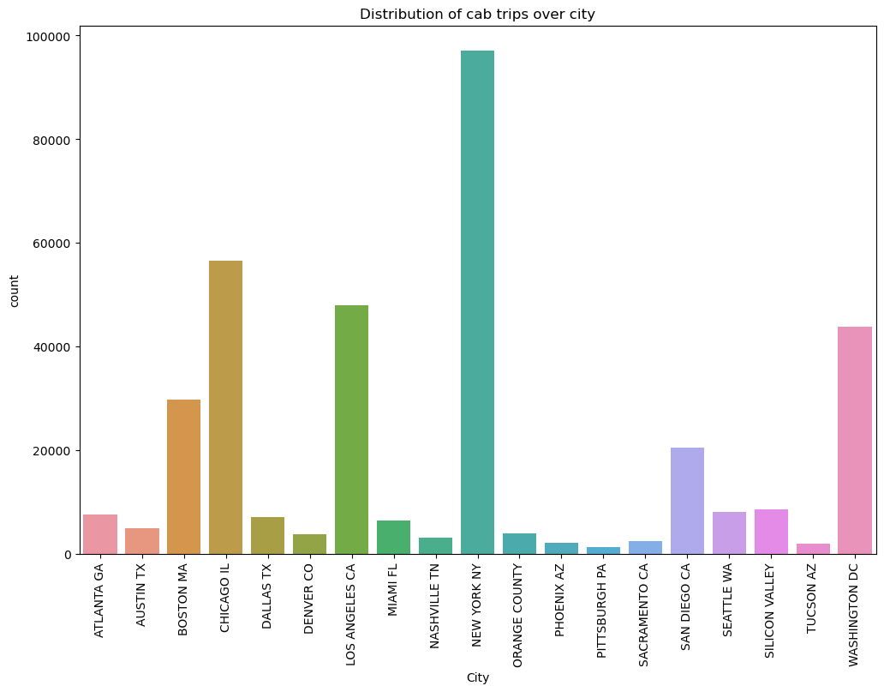
Distribution of cab trips over city
This bar chart displays the count of cab trips in various U.S cities, with New York city leading significantly.
Chicago and Los Angeles also shows high usage but lesser than New York.
Cities like Boston, Austin, Miami, and Silicon Valley present moderate trip counts, while Atlanta, Dallas, and others exhibit lower usage.
Washington, DC has the fewest trips, indicating varying cab service popularity across the country.

Slide 7
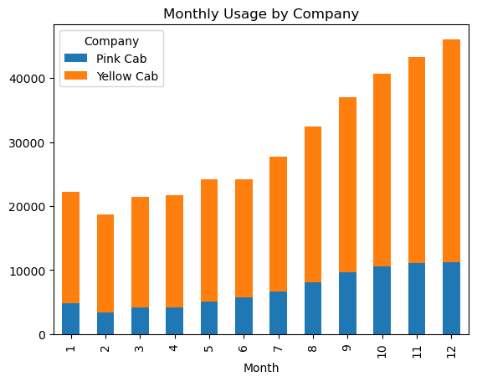
Monthly Usage by Company
The "Monthly Usage by Company" bar chart illustrates the comparative monthly cab rides for Pink Cab and Yellow Cab.
Yellow Cab (in orange) consistently outperforms Pink Cab (in blue) throughout the year.
A seasonal increase is observed for both companies in December, while the early months show the least usage.
The data suggests Yellow Cab's dominance in market share on a month-to-month basis.

Slide 8
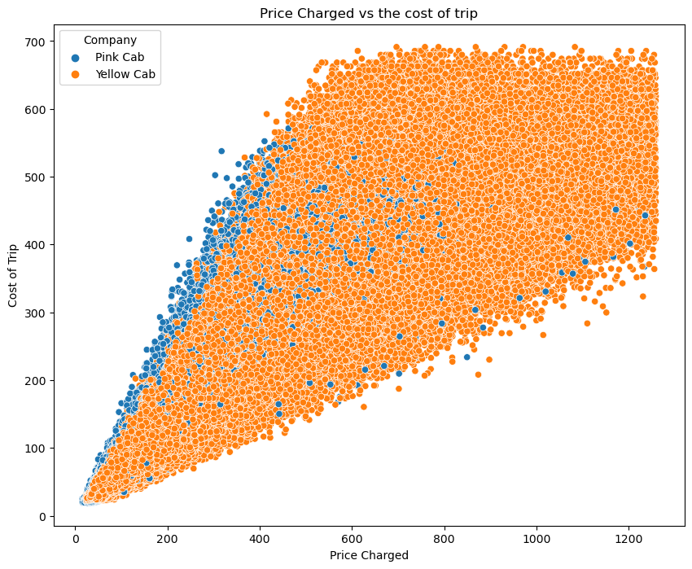
Price Charged and Cost of Trip
The scatter plot "Price Charged vs the Cost of Trip" compares revenue and cost for Pink Cab (blue points) and Yellow Cab (orange points).
The data points spread out, showing that Yellow Cab often charges more than Pink Cab relative to cost.
The densest concentration of trips for both companies is at lower costs and charges, while Yellow Cab's data points extend to higher costs and charges, suggesting a wider range of trip pricing.
This visualization implies a potential for greater revenue per trip for Yellow Cab.

Slide 9
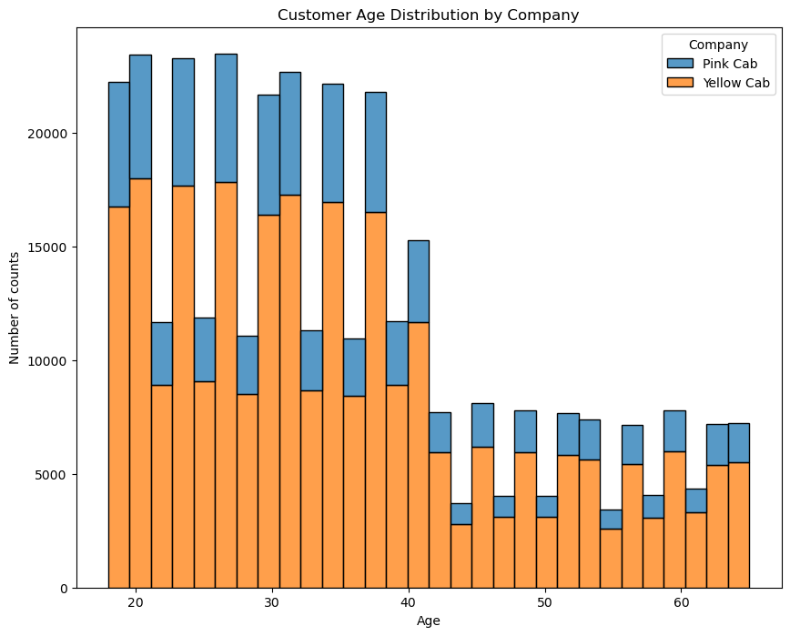
Customer Age Distribution by Company
The bar chart "Customer Age Distribution by Company" compares the age demographics of Pink Cab and Yellow Cab customers.
Yellow Cab dominates in every age group, particularly among younger customers aged 20-40, indicating a broader appeal or market penetration.
Both companies experience a decline in customer counts with increasing age, but Pink Cab's presence is significantly less across the board.
This suggests Yellow Cab's stronger market position and possibly wider acceptance among diverse age groups.

Slide 10
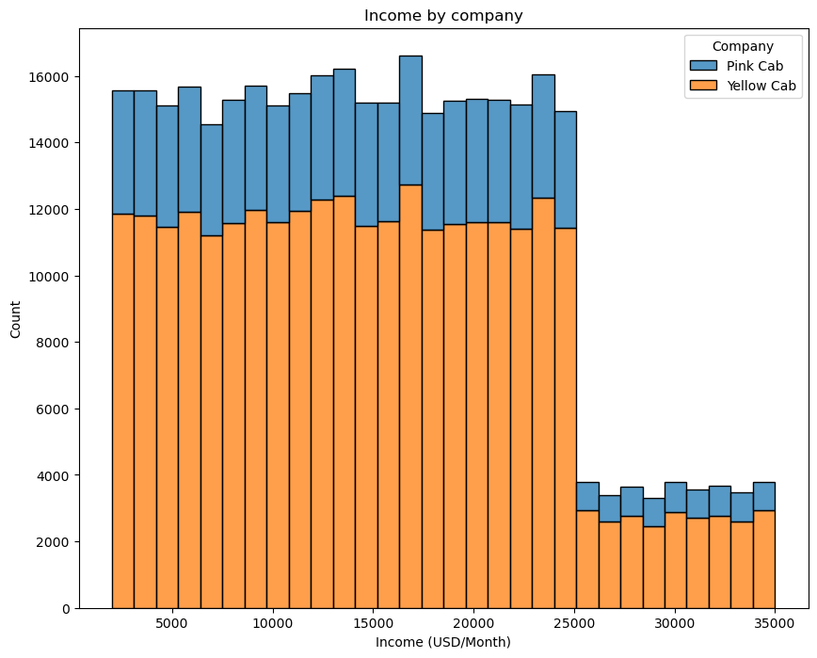
Income by Company
The "Income by Company" bar chart shows customer counts for Pink Cab (blue) and Yellow Cab (orange) across varying income levels.
Yellow Cab consistently attracts more customers in every income segment, with the majority of users falling in the lower to middle income range.
Both companies see a drop-off in customers with higher incomes, indicating a stronger customer base among those with less monthly income.

Slide 11
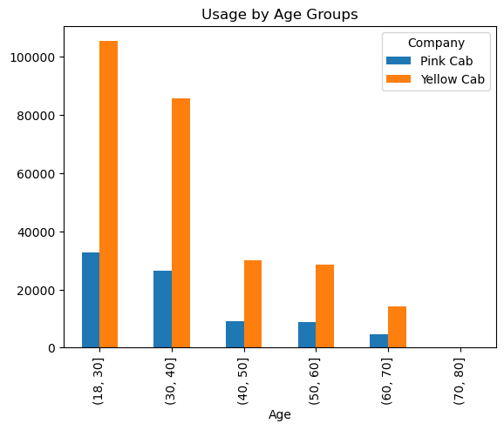
Usage by Age Groups
The "Usage by Age Groups" bar chart compares the customer usage between Pink Cab and Yellow Cab across different age brackets. Yellow Cab shows significantly higher usage across all age groups, with the most pronounced difference in the 18-30 and 30-40 age ranges. Usage for both companies decreases with age, and while Pink Cab's numbers are consistently lower, they follow a similar pattern to Yellow Cab's, with the smallest number of users in the 70-80 age group. This visual suggests that younger demographics prefer Yellow Cab, and that cab usage generally declines with age.

Slide 12
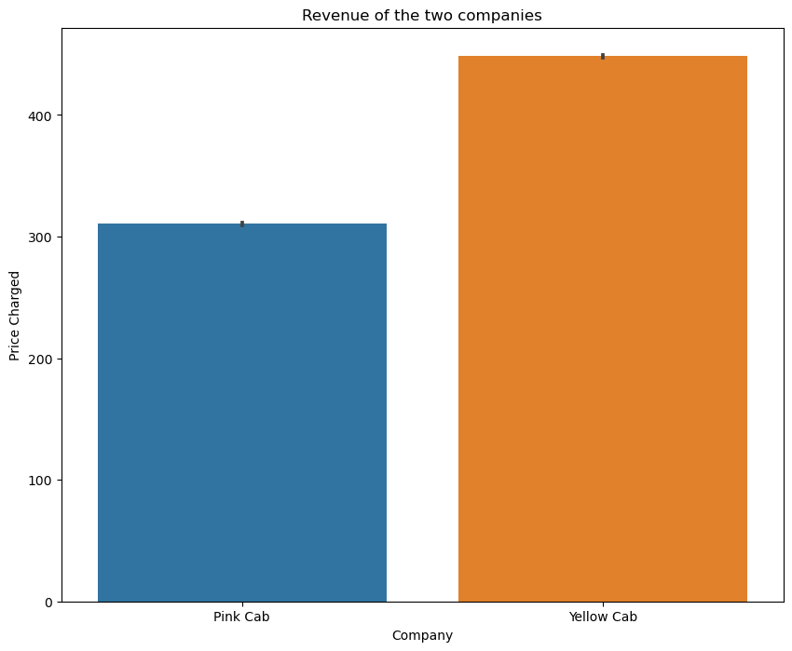
Revenue of the two Companies
The bar chart titled "Revenue of the two companies" compares the revenue between Pink Cab and Yellow Cab.
The bars represent the price charged by each company, with Pink Cab shown in blue and Yellow Cab in orange.
Yellow Cab's bar is substantially higher than that of Pink Cab, indicating a much greater revenue.
The chart clearly displays the difference in financial performance between the two companies, with Yellow Cab appearing to be the more lucrative option.

Slide 13
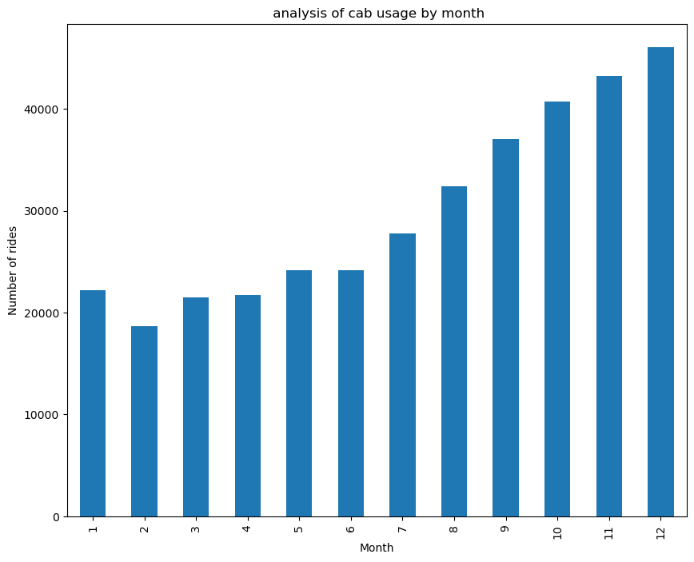
Cab Usage per Month
The bar chart titled "Analysis of Cab Usage by Month" displays the number of rides per month over a year.
There's a noticeable upward trend in cab usage as the year progresses, with January starting lower and a significant increase towards the end of the year, peaking in December.
The chart suggests seasonal variability, with ride numbers growing in the later months, possibly indicating higher demand during the holiday season.

Slide 14
Key Recommendations
Investment Focus on Market Share Leader:
Given yellow cab’s consistently higher usage across all age group and income brackets, as well as its dominance in revenue generation, recommend considering an investment in Yellow Cab as they display a stronger market presence.
2. Seasonal Marketing Strategies:
Implement targeted promotions during peak seasons, especially in the later months of the year, to capitalize on the increased demand as indicated by the rise in cab usage.

Slide 15
Key Recommendations
3. Pricing strategy Evaluation:
Analyze the pricing strategy of both the companies, as the data suggest that the yellow cab might have a higher flexibility due to its larger customer base and could be commanding higher prices without losing demand.
4 . Target Growth in Younger Demographics:
As the data shows higher usage of cab services among the 18-40 age range, marketing efforts could be intensified in this demographic to maximize customer acquisition and retention.

Slide 16
a
Thank You

